Slide 1
Frontend Hackathon
Progress report (Bakery or restaurant page)
Time completed: 24 hours

Slide 2
Components added/changes made
Contact section
Location map
Minor bug fixes
Improved styling in the opening section

Slide 3
Contact section
(Next slide)

Slide 4
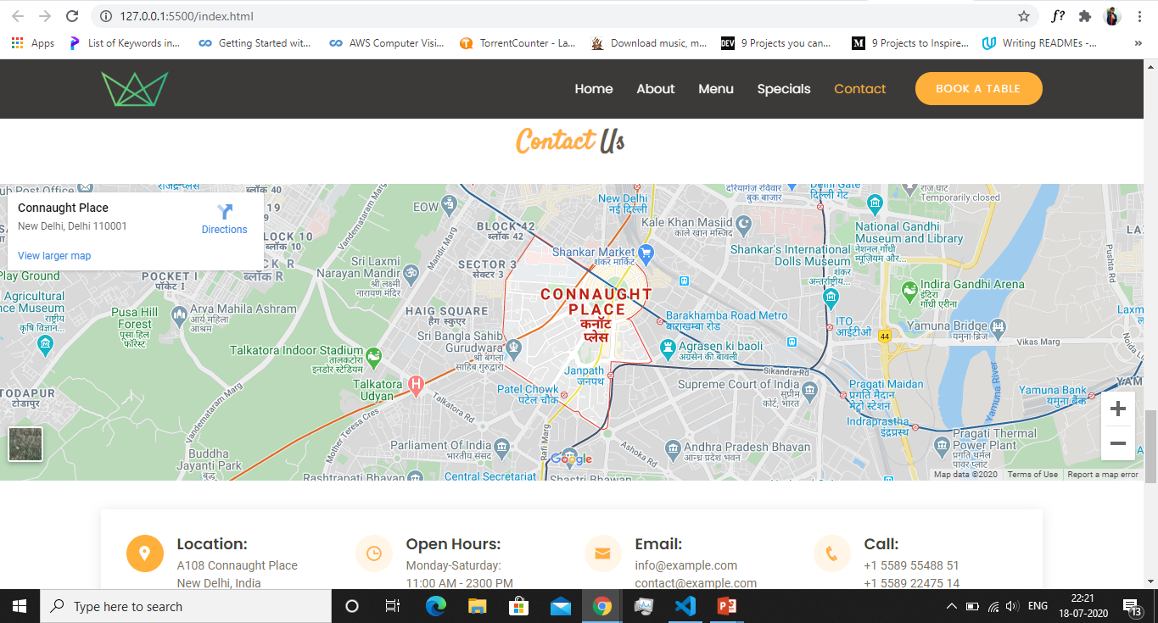

Slide 5
Contact Us Section
Added a map with its iframe src attribute set to the location.
Added information like contact number, email below the map.
Added nice hover effect to the icons as we hover over the information section.

Slide 6
Form section
(Next slide)

Slide 7
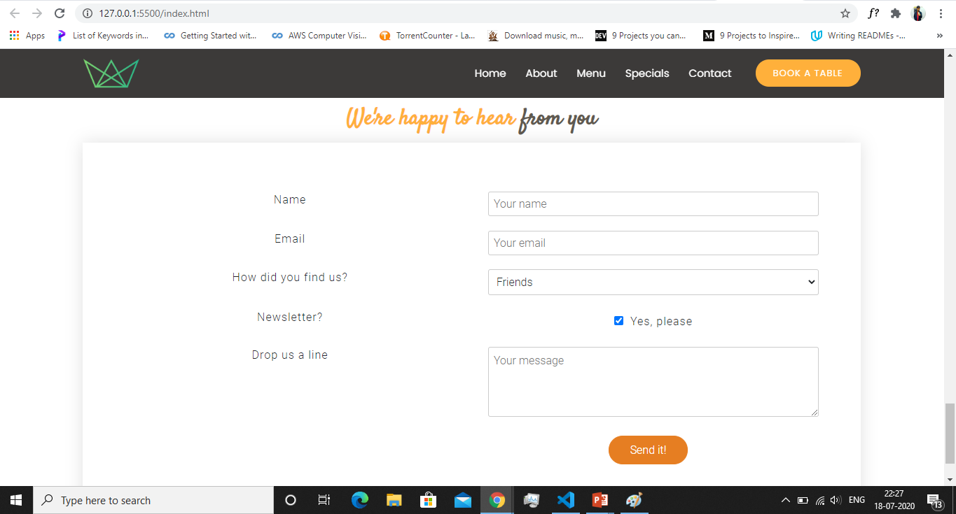

Slide 8
Form Section
Added all the required input tags like name etc.
I also added an option to add the news letter if the customer wants to subscribe to the newsletter of the website.
The whole section has a box-shadow effect, which gives it a 3D look.

Slide 9
Future Plans
Make edits in the opening section.
Add a testimonial section to the page
Add a footer*
Add a premium section that displays three exotic/best dishes of the restaurant.
Add more styling to the website wherever required.
If time left, I’ll also add a booking section that would make the process of reservation easy.
(These are the sections that I’ll work on during the second half of the Hackathon and will keep on improving the website)

